Slide 1

ACADEMIC SENATE PRESENTATION | What the heck is a Deputy Sector Navigator, Strong Workforce Program (SWP) and Much More!
Coastline Community College, April 16, 2019
Notes:
Regional DSN welcomes attendees to the session and introduces presenter for the session
Presenter can do further introduction of their background before launching into slides

Slide 2
What we will cover this session
Overview of CCC Doing What Matters for Jobs and the Economy
Sectors and Navigators and Deputy SNs
What it does and can mean?
Heard about the K12 SWP?
Info and Data
  Preparing (now) for the Gig | Disruptive Economy
  Critical data sources for your planning and knowledge
  And, what I can partner, consult, collaborate with you on and support over the next few years.
Notes:
In this session we are going to cover the following:
Provide an overview of DWM
Provide some workforce development resources and business development resources available to businesses that can help you become more competitive and help you diversify into other contracting opportunities
Provide info on some of the other CASCADE Grant resources
The main goal of this session is to provide you with resources to help you become more competitive.

Slide 3
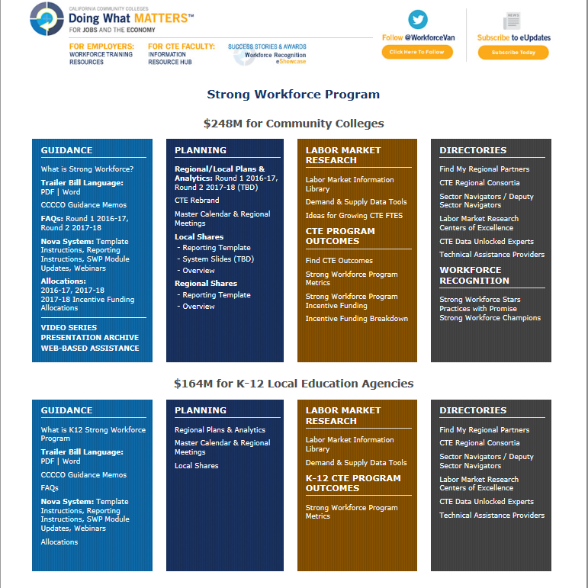

Slide 5

Sector | Sector Navigator
Advanced Manufacturing | Gurminder Sangha
Advanced Transportation and Renewables | Jannet Malig
Agriculture, Water, & Environmental Technologies | Nancy Gutierrez
Energy, Construction, & Utilities | Jim Caldwell
Global Trade & Logistics | Leah Goold-Haws
Health | John Cordova
ICT/Digital Media | Steve Wright
Life Sciences/Biotech | Terri Quenzer
Retail/Hospitality/Tourism | Vacant
Business and Entrepreneurship | Charles Eason
http://doingwhatmatters.cccco.edu/Contact.aspx
doingwhatmatters.cccco.edu
Notes:
There are three key aspects to the Doing What Matters framework. First is that it is Sector Based. These are the ten Sectors that the Community Colleges are currently focusing on.

Slide 6
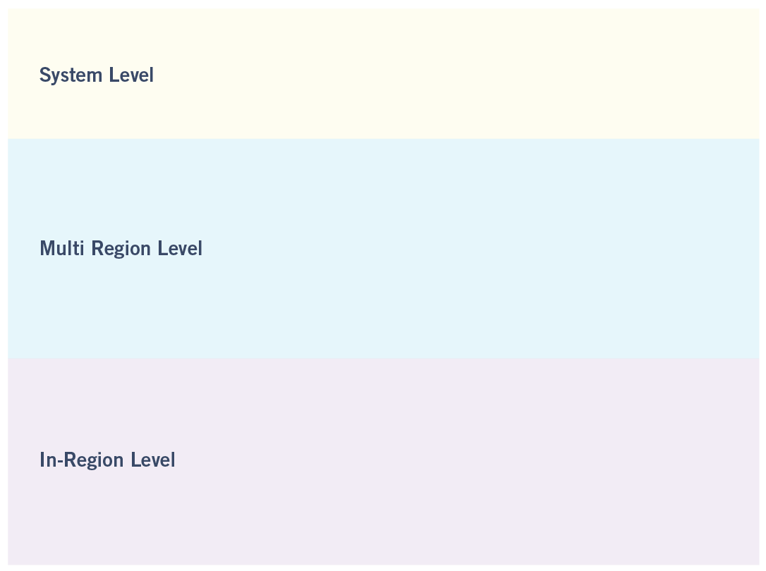

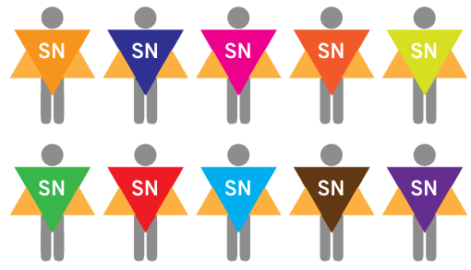

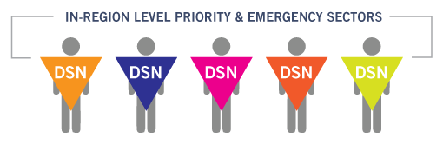

doingwhatmatters.cccco.edu
Notes:
The second aspect of the Doing What Matters Framework is that it is key talent based.
There is a statewide Sector Navigator for each of the ten Sectors who is a subject matter expert for that Sector and first point of contact for the Sector.
At the regional level, there are Deputy Sector Navigators who work with colleges in the region to connect business and industry with education. There are also Technical Assistance Providers such as the Centers of Excellence who can provide supply and demand data.
There are also Regional Consortia to help manage the resources and funding in the region such as the $200M in SWP funds the system is managing.

Slide 7
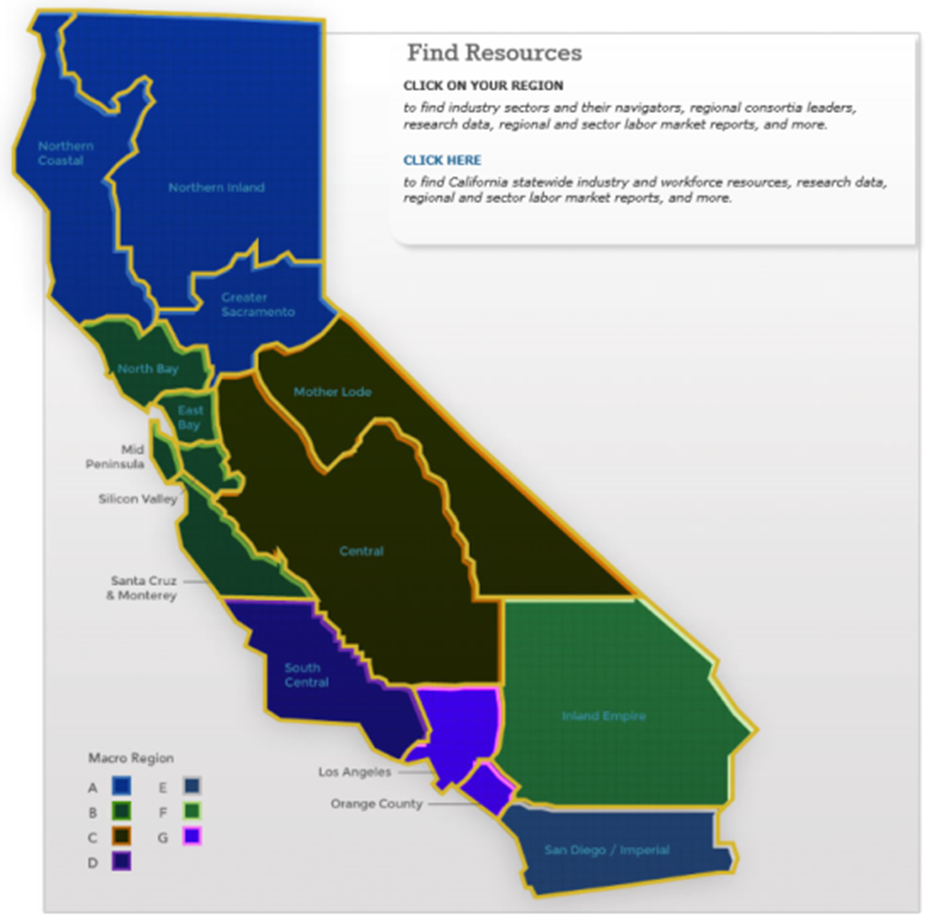
doingwhatmatters.cccco.edu
Notes:
Lastly, the Doing What Matters program is regionally based.
There are seven macro regions with several sub regions. For example, LA/Orange County is considered one macro region but split into two sub-regions and the Bay Area is also split into two sub-regions.
The map I was showing you earlier on the DWM site provided contact info by these regions.

Slide 8
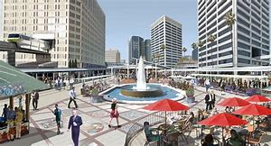
OC At-A-Glance…
1st in medical device manufacturing
1st in transportation innovation and master planned communities
2nd largest workforce in California
3rd most diverse tech sector in U.S.
2.8% unemployment rate
5th most educated county in the U.S.
6th largest county by population in the U.S.
Innovation is seen as a “driving force of economic development” *

Slide 9
OC At-A-Glance Table | Centers of Excellence, OC
DWM Sector
Annual Openings
Below Middle Skill
Middle Skill
Above Middle Skill
Orange County Annual Openings for Middle Skill Jobs (2018-23)
OC Entry- Level Wages
OC
Median Wages
Orange County FTES (2017-18)
Orange Awards (2017-18)
Business and Entrepreneurship | 49,630 | 7,240 | 30,990 | 11,400 |  |  |  |  |  |  |  | 30,990 |  |  |  | $16.50 | $28.70 |  |  |  |  |  |  |  |  |  | 8,575 |  |  |  |  | 4,563
Retail, Hospitality and Tourism | 23,050 | 2,910 | 16,820 | 3,320 |  |  |  |  |  | 16,820 |  |  |  |  |  | $16.30 | $28.90 |  |  | 1 | ,544 |  |  |  |  |  |  |  | 6 | 14
Health Information and Communication Technologies (ICT) - Digital Media Energy, Construction and Utilities Advanced Manufacturing Advanced Transportation and Logistics Global Trade Education and Human Development None Agriculture, Water and Environmental Technologies Life Sciences - Biotechnology Public Safety | 14,940 330 13,890 720 19,220 3,900 10,480 4,840 10,520 2,460 8,070 7,900 550 6,980 370 8,040 2,310 5,700 30 7,520 4,160 3,360 6,220 5,210 1,010 5, 2 3,100 2,580 520 1, 2,410 80 1,940 380 1, 1,750 1,660 100 7 930 50 790 80 |  |  |  |  |  |  | _{13,890} $16.50 $25.60 10,480 $19.00 $31.20 ₃₂ 8,070 $15.30 $27.20 Below Middle Skill ,980 $14.50 $22.40 ₁ 700 ^{Middle Skill} $14.70 $23.00 ₁ ¹⁶⁰ Above Middle Skill ^{$20.20 $41.00} 62 80 $15.20 $23.40 ₂₉₅ 40 $16.60 $26.40 ₃₅₅ 60 $14.20 $26.00 100 $27.90 $39.90 |  |  |  |  |  |  |  |  |  |  |  | , , | 2,05 400 349 2,27 | 2 3 | 3,55 | 5,0 7 | 83 |  |  |  | 66 5 6 37 65 29 | 1,2 0 24 85 980 3 | 1,746 92 1,833
6
5,
4,
210
,5
$11.80
$17.60
9
6
90
6,254
Source: EMSI Data Set 2018.4 (Pull date: 11/19/18) and Chancellor's Office Data Mart

Slide 10
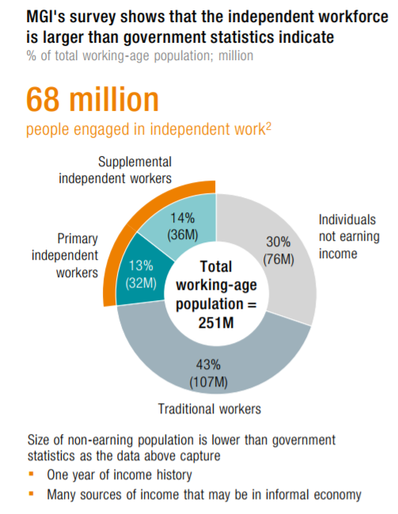

Preparing for the future…
Notes:
There are currently about 68 million people participating in the Gig Economy.
Review categories of Gig Workers

Slide 12

Notes:
This is an interesting slide from the study which shows that in 2017, 36% of freelancers were making more than $75K, 12% $100K - $149K, and 5% making more than 150K
The trend is increasing.

Slide 13
Notes:
This slide from the study is also very interesting.
It shows that freelancers tended to update their skills more often than those who were not freelancing with 55% updating their skills in the last six months versus 30% for those that are non-freelancers.
This bodes well for Community Colleges since we are well positioned to provide that skills updating.

Slide 14

doingwhatmatters.cccco.edu
Notes:
As part of the Gig Economy project, we subcontracted with a Gig Economy Platform called Loconomics headquartered in San Francisco to develop some tools to help match up our students with businesses seeking people to perform freelancing jobs.
This is a cooperative platform owned by the freelancers so it avoids the high commissions of other Gig Platforms which can be as high as 40%.
Has an element that allows local businesses to post freelancing jobs on the site associated with the local college in their area.

Slide 15
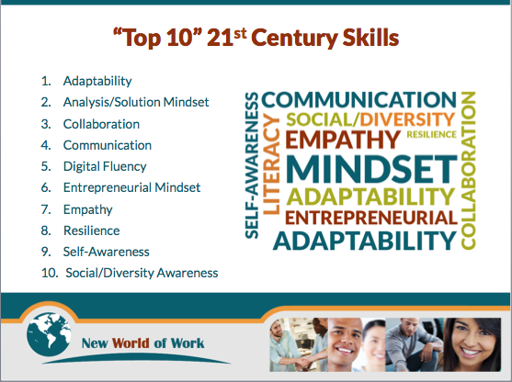
New World of Work: 21st Century Skills
Notes:
The next workforce development resource I want to share with you is around soft skills. This is probably the number one request we hear from businesses.
The CCC developed a pilot called the New World of Work: 21st Century Skills to address the skills.
Review list of skills
The training consists of hands on exercises and videos.

Slide 16

NWOW: 21st Century Skills Badges
Notes:
Students who complete the NWOW training can receive digital badges
There is also an employer verification component where employers can verify that the students are proficient in these skills where it adds a digital ribbon to the badge.
The badges are managed by the Foundation for CA Community Colleges.

Slide 17

doingwhatmatters.cccco.edu
Notes:
Another program that may be useful for defense supply chain businesses is the CCCMaker program where the Chancellor’s Office invested $17M to start or expand makerspaces at colleges across the state.
24 Colleges are participating.
There is a requirement to create 800 internships for students.
Great program if your business is looking for employees with STEM skills.

Slide 18
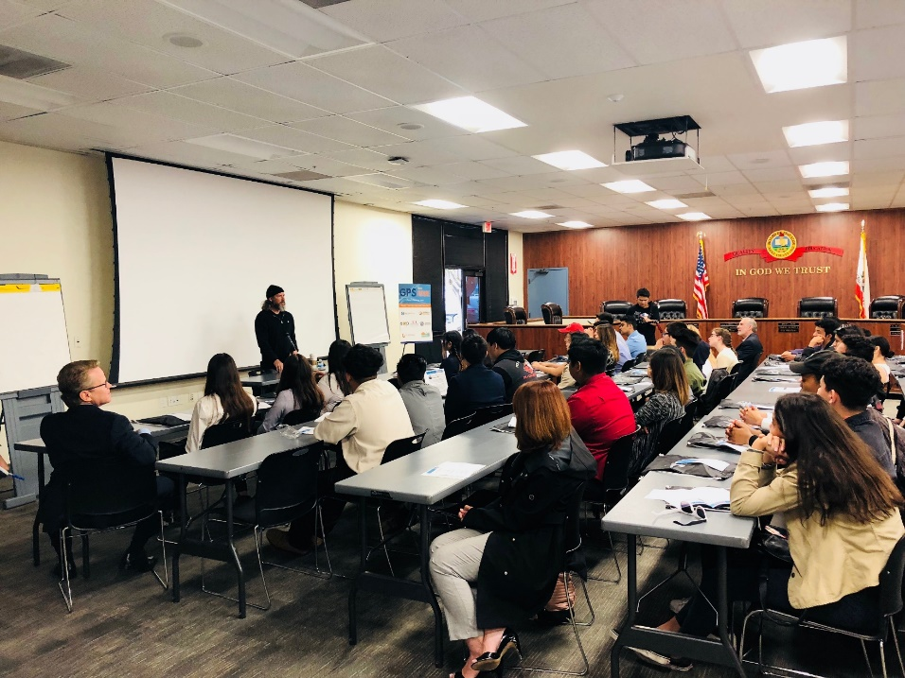
Regional Actions underway next few years…
Dual Enrollment
Student Engagement
Entrepreneurship College and Regional Pop-Ups
Curriculum Alignment
LinkedIn Strategic Group: BusOCNET
GPS Your Future
Guided Pathways: Focus on specific programs
Professional Development

Slide 19

Thank you!
Contact: A. Cathleen Greiner, PhD
Deputy Sector Navigator, Business and Entrepreneurship
Hosted by Santa Ana College
2323 N. Broadway, Ste.201 | Santa Ana, CA 92706 | 714.564.5202
Greiner_cathleen@rsccd.edu

